Slide 1
Programming Skills Workshop
Lesson 2 – Windows Administration

Slide 2

Course Background – One More Time
Problem:
Too many ICT students lack fundamentals, struggle through first semesters and never catch up.
Not knowing at first is okay (really!) – but you’ll need to work a little harder to keep up.
This course is designed to get everyone ready for ICT studies

Slide 3
Course Schedule
Tues 22nd – Intro
Wed 23rd – Windows Administration
Thu 24th – Windows Command Line
Wed 30th – Programming Tips & Tricks
Thu 31st – Programming Tools
Wed 6th – Linux
Thu 7th – More Linux & Languages
Wed 13th – Group Work & More Tools
Thu 14th – Open

Slide 4
Course Resources
Course items up on GitHub
https://github.com/kcarta/programming-workshop
These will be updated weekly

Slide 5
Today’s Lesson
Guided tour of Windows
What you’ll learn:
Skills: Administering and troubleshooting Windows
Knowledge: Windows configuration settings through a whole bunch of tools
Values: Looking at Windows as a developer, not a user

Slide 6
Using Windows

Slide 7
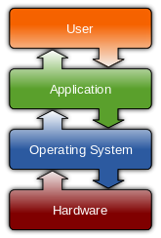
Operating Systems
An operating system (OS) is special software, responsible for gluing the hardware components on a computer to the software components.
Usually, an OS will be installed alongside a number of tools and programs, such as a primary Graphical User Interface (GUI), configuration tools, and productivity applications.
The most widespread operating systems are Android, Windows, iOS and OS X.
Source:
http://en.wikipedia.org/wiki/Operating_system

Slide 8
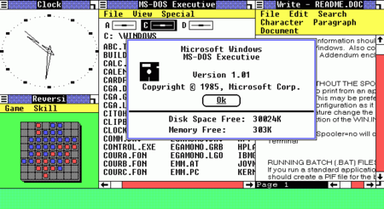
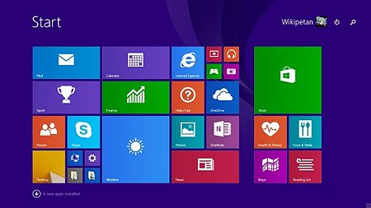
Windows
Windows is an operating system that comes installed with a GUI desktop and a large collection of built-in configuration tools.
Windows used to have new major versions every few years (XP, 7, 8.1), but is now offered ”as a service”.
Unlike Mac OS X and Linux, Windows is not related to the influential Unix family of operating systems.
Source:
http://en.wikipedia.org/wiki/Microsoft_Windows

Slide 9
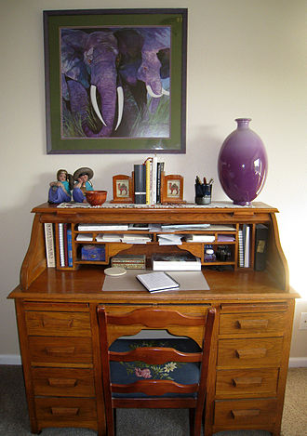
The Desktop Metaphor
The Desktop Metaphor is the concept behind the user interface in virtually all operating systems.
Desktop interfaces on a computer represent the setup in a real office, where paper files are stored in collections of folders, and productivity tools like calculators and spreadsheets are often on-hand.
Source:
http://en.wikipedia.org/wiki/Desktop_metaphor

Slide 10
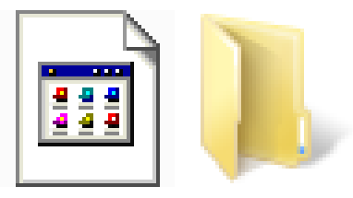
Folders and files
The primary software component on a computer is the file.
Every program on your computer is made up of files, and most of the programs on your computer are designed to use and create files.
All of the files on a computer are organized into folders.
The collection of files and folders on a computer is called the File System.

Slide 11
Windows File System Hierarchy
C:\
Users\
Username\
Other user directories
Program Files\
Program directories
Windows\
System files and directories
Desktop\
Documents\
Downloads\
OneDrive\
Various personal files and directories
The primary hard drive is usually named C:\

Slide 12
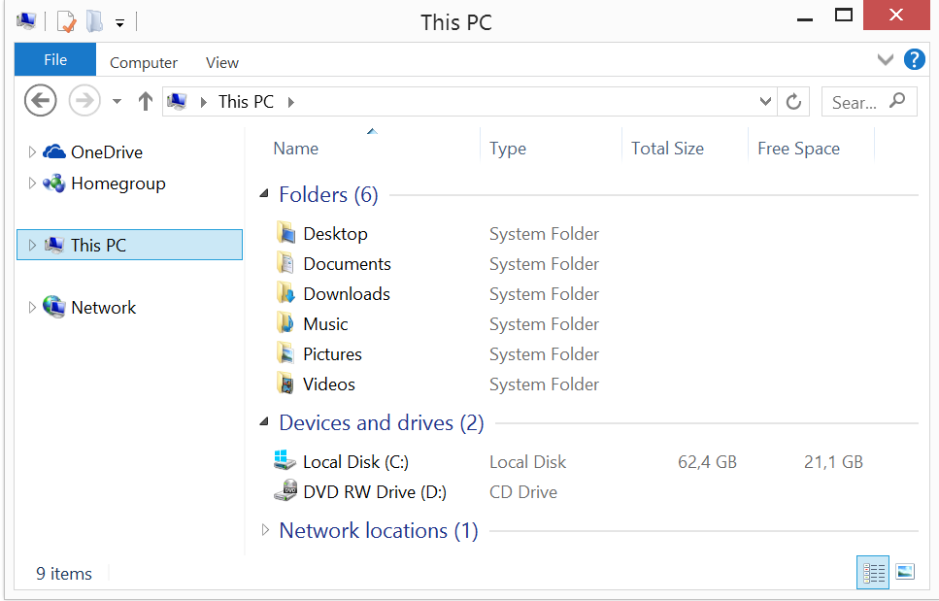
Using File Explorer
File Explorer is the default graphical program used to navigate the file system.
Be sure to spend time tweaking File Explorer until it suits your personal taste.

Slide 13
Where to look for files/programs
Programs are usually installed to C:\Program Files(x86)\
64-bit programs will sometimes be installed to C:\Program Files\
Documents and media are usually saved in the current user’s folder in C:\Users\Username
Many programs have their configuration and storage files saved in AppData.
Windows system files are stored in C:\Windows\
You should never need to change anything in this folder

Slide 14
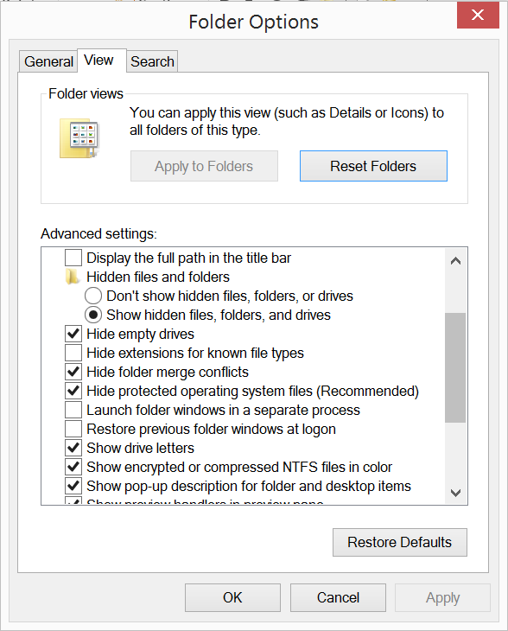
Folder Options
Change the default folder options so you can see hidden files and file extensions.
Folder Options is found in the Control Panel.

Slide 15
Customizing your file system
Common directories for programmers to create:
C:\bin\
For programs that run on the command line
C:\src\
For your code
Keep your folders organized!
Nothing is more tedious than watching someone stumble through their file system looking for a file ☹

Slide 16
Naming Conventions
When you name a file or folder, follow these simple rules:
Names should be simple, but still meaningful.
Use underscores or dashes instead of spaces:
long_folder_name file-name-2015
Avoid using symbols (\/:*?”<>|).
Follow conventions
Java has specific rules regarding capitalization of classes, for example.
Regardless what you decide to do, be consistent!

Slide 17
Mastering the Windows Key
The Windows Key allows you to access a wide range of functionality with simple keystrokes.
Common shortcuts:
= Open the Start Screen
+ Search Term = Search for a file, folder or program
+ Left|Right = Move a Window to the left or right half of the screen
+ Up|Down = Maximize or Minimize a Window
+ L = Lock the computer
+ E = Open File Explorer
A huge list can be found at: windows.microsoft.com/en-us/windows/keyboard-shortcuts

Slide 18
OneDrive (or Google Drive, Dropbox, etc)
Files on your computer that aren’t backed up can be lost forever. Try to avoid keeping important files in your User folder or in Documents.
Storing your important files in a cloud service is a good idea
Your files can be accessed from anywhere
It’s far more difficult to lose files
Most services have fairly high free storage limits
As a developer, it’s best to keep your computer clean and organized
I completely reinstall Windows every few months to get a clean slate

Slide 19
Exercise 1: Explore the File System
With File Explorer set up properly, let’s poke around our file system!
Open up File Explorer
Go to your C:\ drive
Look in the Windows folder (Is anything in the System32 folder familiar?)
Look at what programs are installed in Program Files (both folders)
Go to your User folder and see what’s there.
Go to AppData in your user folder. Try to see what your applications are storing.

Slide 20
Windows Administrative Tools

Slide 21
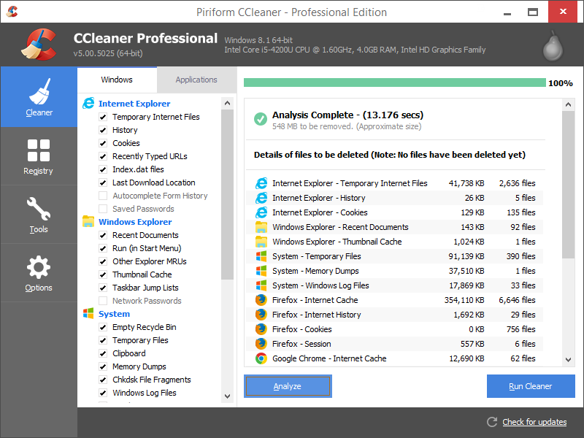
Note on Third-Party Tools
There are countless tools on the web for maintaining Windows.
As a programmer and power user, you will only very rarely need these.
At best, they provide services that you should already know how to do.
At worst, they can permanently damage your computer.
CCleaner’s Registry tool is an example of a service that is not needed, and can be very harmful if misused!

Slide 22
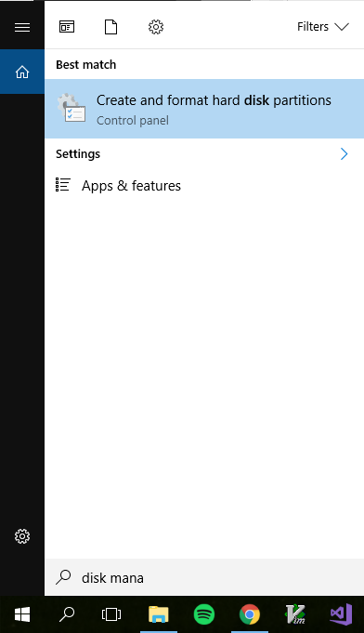
Finding and Opening Tools
In older versions of Windows, tools were accessed through Run or in the Control Panel.
In Windows 10, the search bar is your friend.
Any Windows tool can be opened by just hitting the Windows key and typing in the name of the tool.

Slide 23
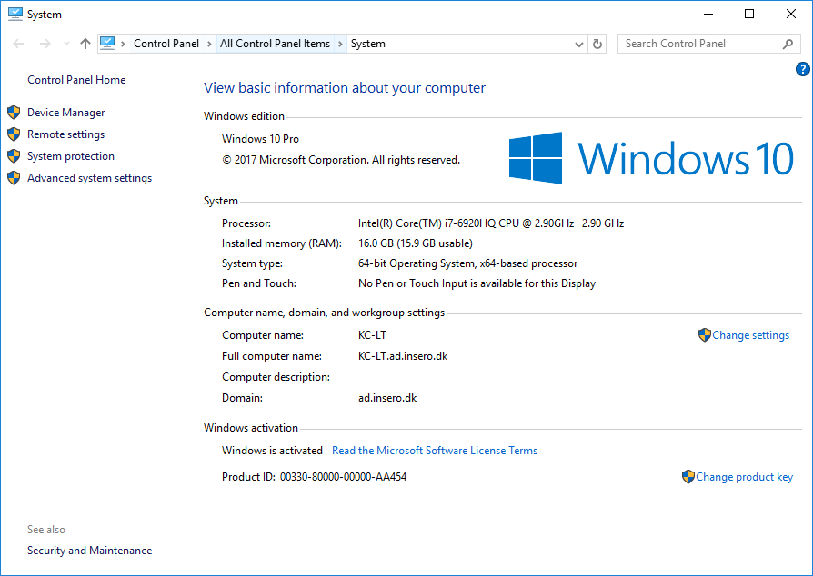
System
System provides access to computer settings, like Computer Name and the all-important PATH
System can be found by:
Right-clicking on the Start Menu
Searching for ”System” (not to be confused with System Information or System Configuration)

Slide 24
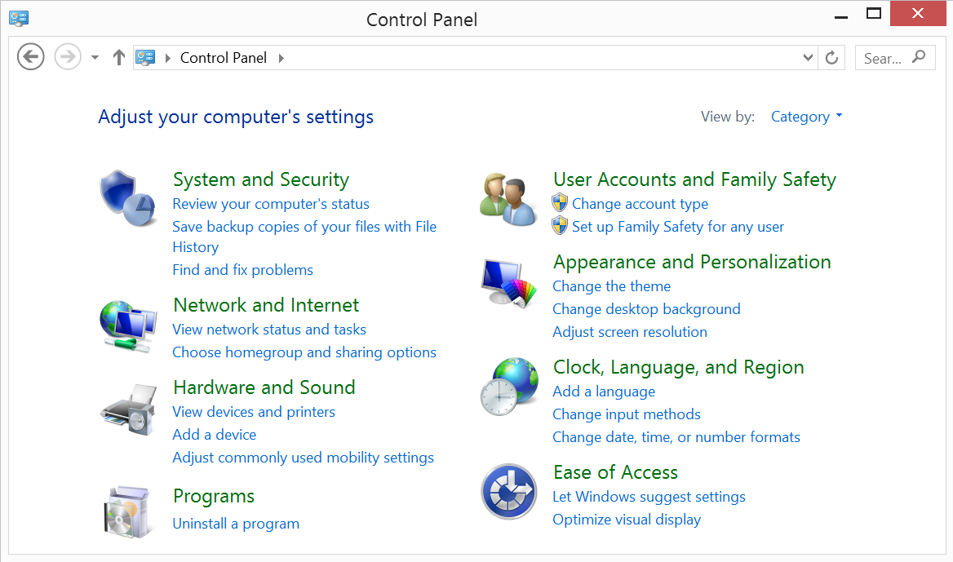
The Control Panel
Most problems in Windows are solved through the Control Panel.
Opening the Control Panel:
Right-click in the lower-left of the screen. Find Control Panel in the menu.
In the File Explorer, click on This PC , select the Computer tab, then select Open Control Panel.

Slide 25
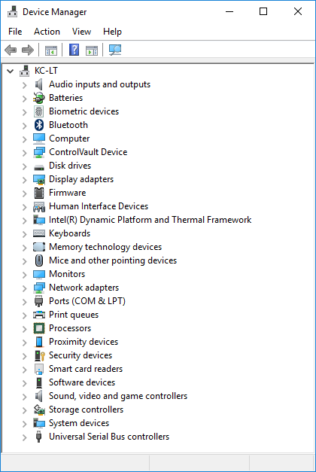
Device Manager
Hardware and Driver issues can be troubleshooted in Device Manager
Opening Device Manger:
- Right-clicking on the Start Menu
- From Control Panel or System

Slide 26
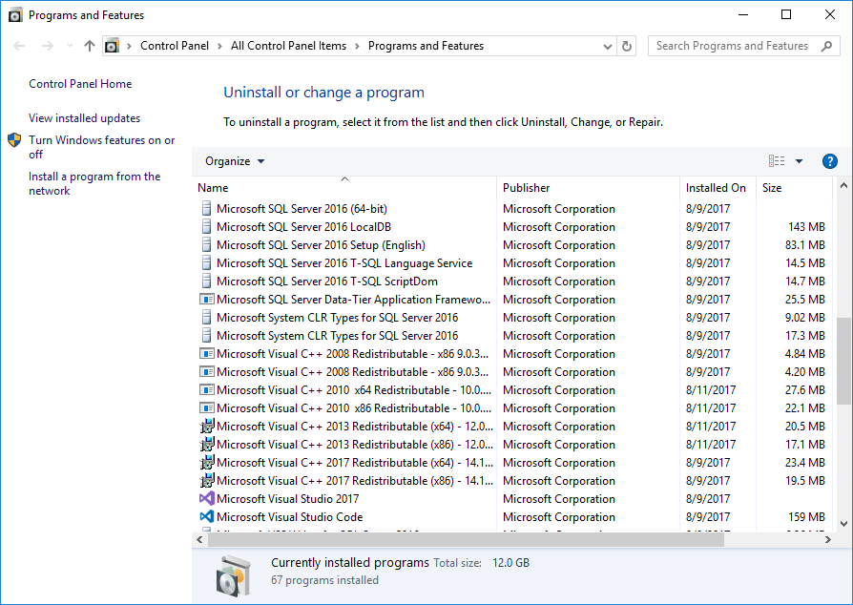
Programs & Features
Programs can be viewed and uninstalled in Programs & Features.
This tool is slowly being replaced by the one in Windows 10 Settings (but it is still more useful for now).

Slide 27
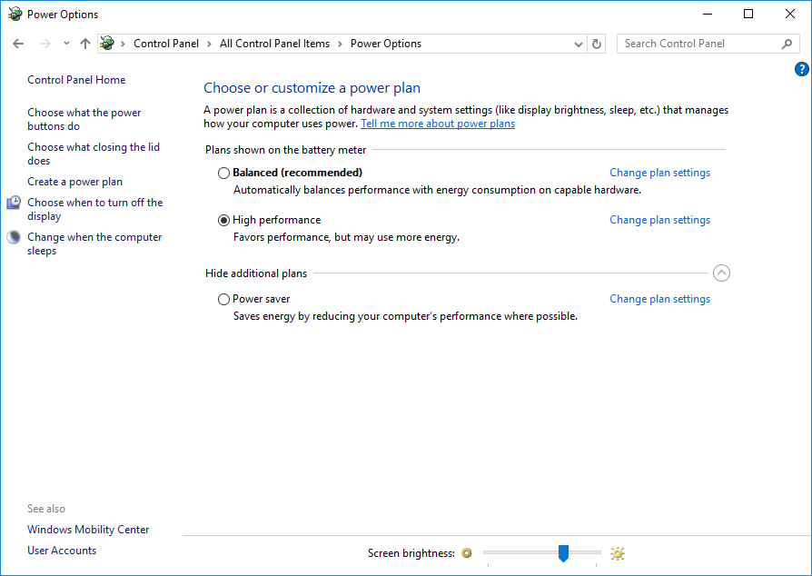
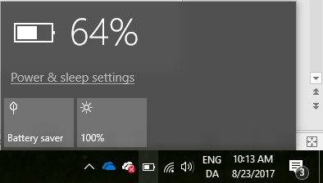
Power Options
Use the settings in Power Options to configure how Windows balances performance and battery life.
For a development laptop, performance is usually more important. Consider using High performance by default.
When needed, Battery saver can be temporarily enabled in the taskbar.

Slide 28
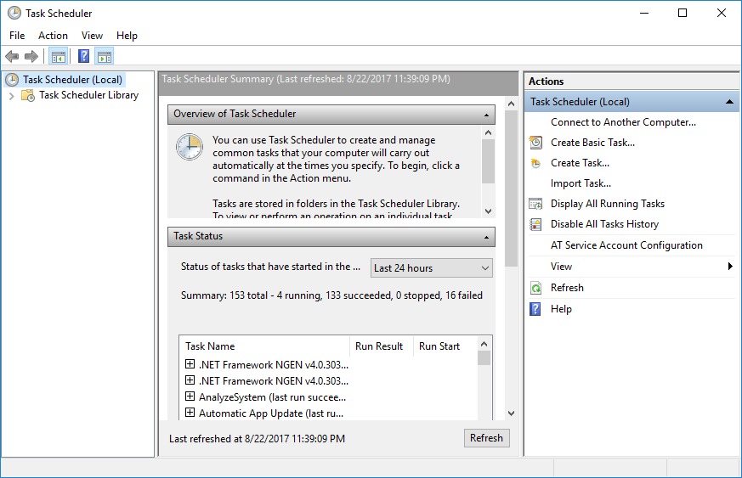
Task Scheduler
For special purposes, it can be helpful to run programs at certain times, like when the user logs on.
The Task Scheduler can be used to perform actions in response to specific events. It is surprisingly easy to use.

Slide 29
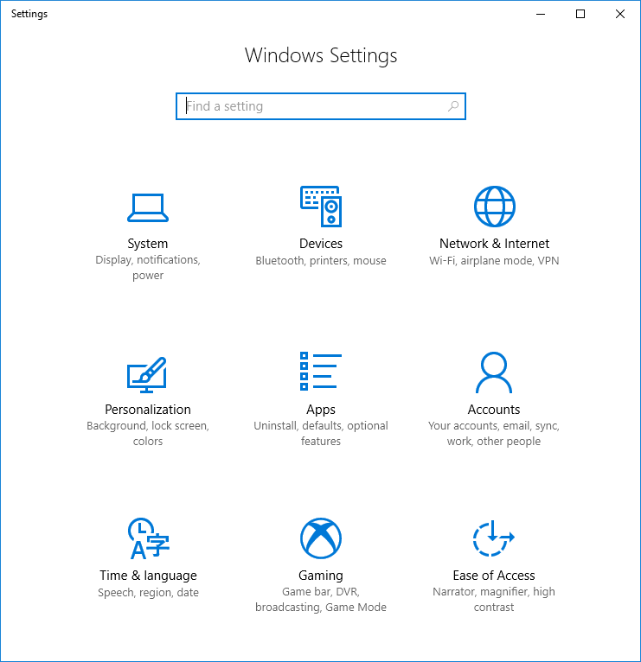
Windows 10 Settings
In Windows 10, Microsoft is trying to move all settings over to a new look and feel.
Some settings are now easily found here, so it is good to be familiar with this new tool.
But anything advanced will require using the old tools.

Slide 30
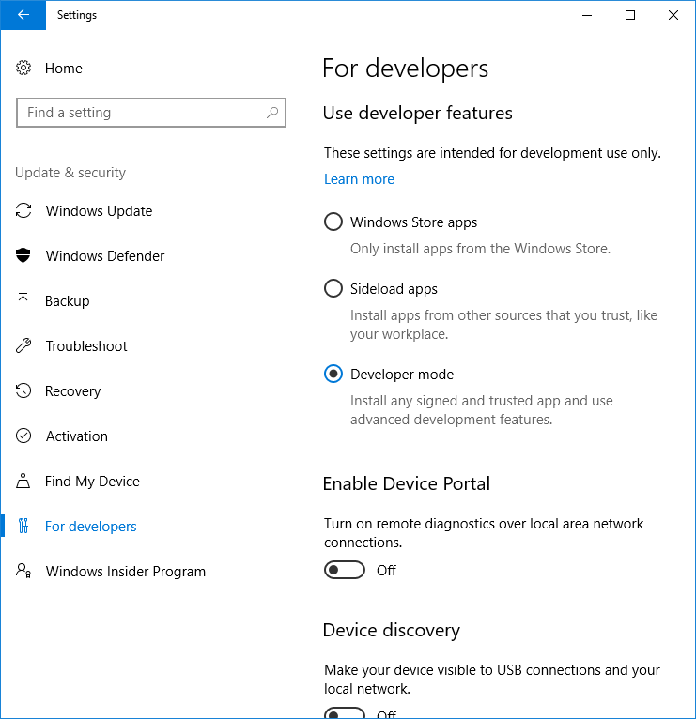
Windows 10 Developer Mode
Recent updates have added a For developers tab to the Windows 10 settings.
These make it possible to develop applications that run through the Windows Store.
The latest update also adds a list of handy options that makes Windows easier to use for developers.

Slide 31
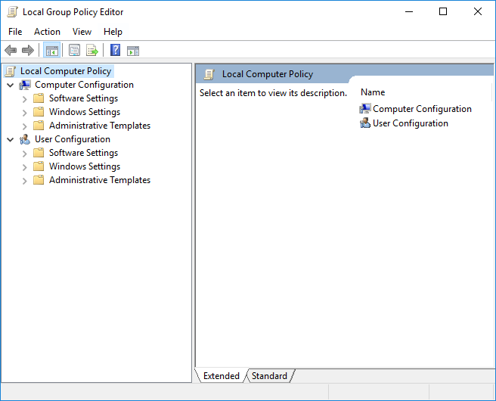
Group Policy Editor
Some system-wide settings are managed in the Group Policy Editor.
Occasionally, you will need to come here to enable or disable features of services.

Slide 32
Exercise 2: Disable Cortana
Cortana can be a useful assistant for home computers, but it takes up valuable resources on a developer laptop. Let’s disable it.
Using the Group Policy Editor, figure out how to disable Cortana.
Hint: Cortana is part of the Search service.

Slide 33
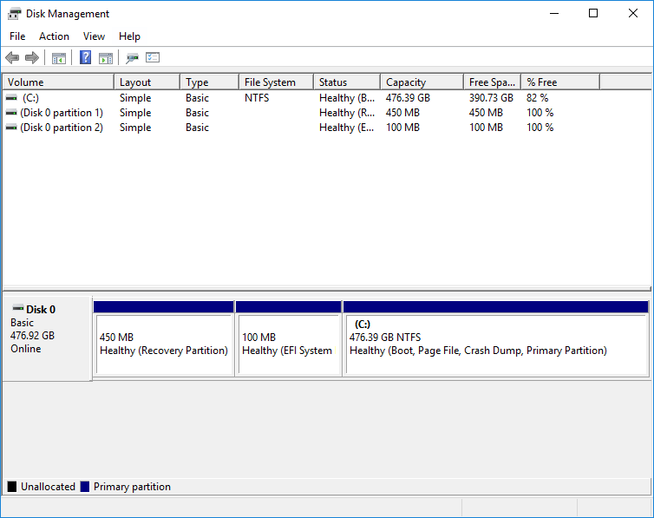
Disk Management
If you have a large hard drive or several hard drives, you may want to split them into partitions
Your drives and partitions can be managed in the Disk Management tool.
Misusing this tool can cause your drives to be deleted, so be careful!

Slide 34
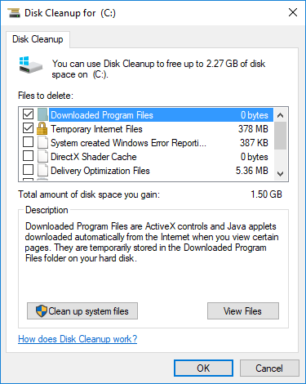
Disk Cleanup
Laptops tend to come with smaller hard drives, so disk usage is a priority.
Every month or so, it can be helpful to run Disk Cleanup to see what file space can be recovered.
Always select Clean up system files, but read what these do before deleting!

Slide 35
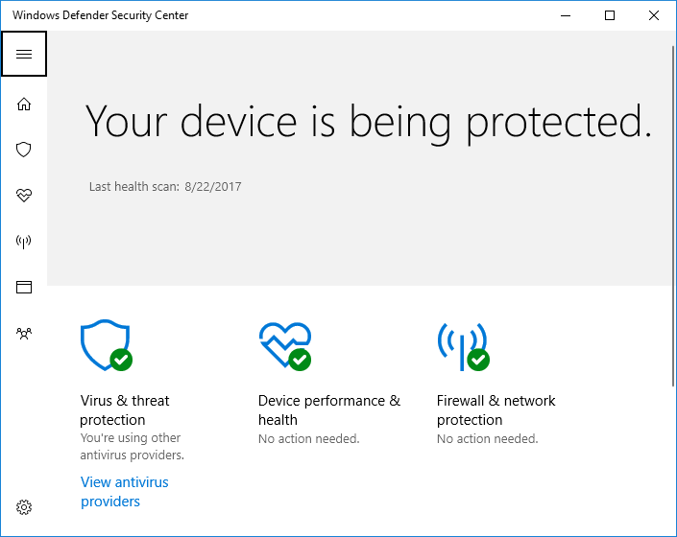
Antivirus
Antivirus programs protect your computer from outside attacks and malware.
However, they also use up precious system resources.
Windows Defender is built-in to Windows, and balances protection and performance.
Unless your internet use puts you at a high risk for malware, there is no need to use any other antivirus protection.

Slide 36
Windows Troubleshoot Tools

Slide 37
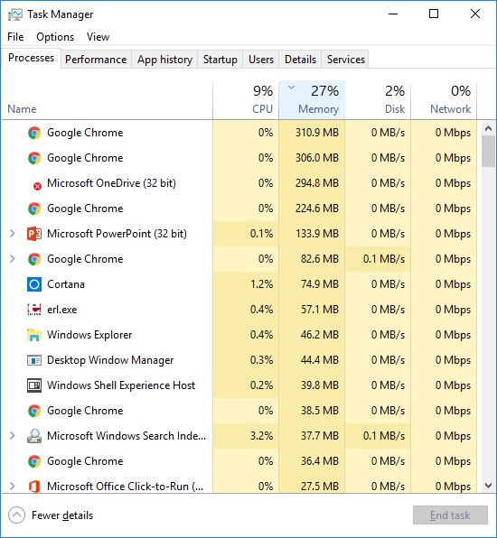
Task Manager
When troubleshooting and debugging wayward programs, Task Manager is your best friend.
Task Manager is useful for viewing performance stats and closing frozen programs.
In a pinch, you can reach Task Manager by pressing Ctrl+Shift+Esc

Slide 38
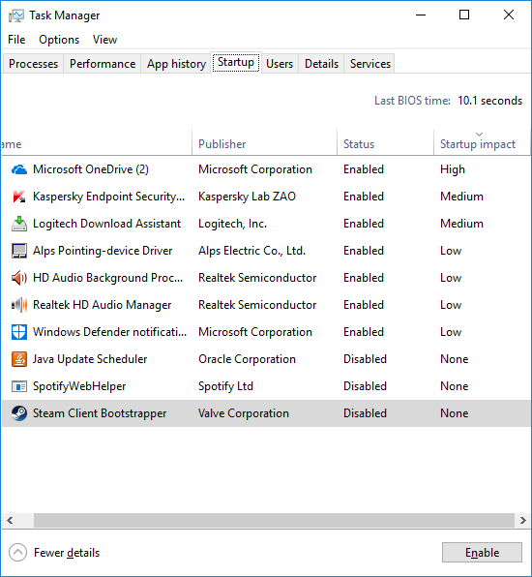
Task Manager - Startup
Over time, your computer will pile up with programs that want to start automatically on login.
Task Manager lets you view and manage startup programs.
It’s best to disable as many of these as you can, and run them manually when needed.

Slide 39
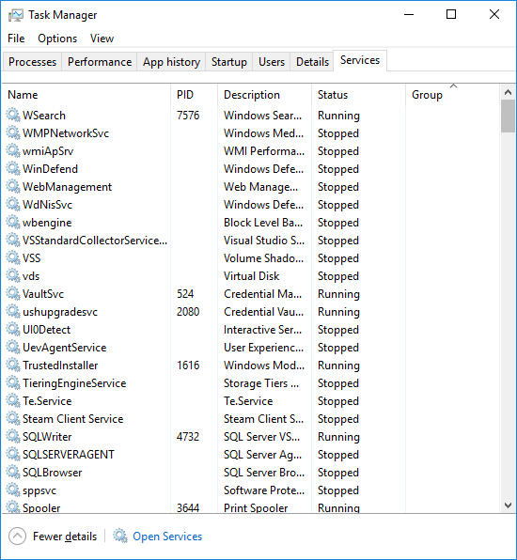
Task Manager - Services
Services can be overviewed and managed from Task Manager.
This is a good place to restart failing services, or permanently disable troublesome services.

Slide 40
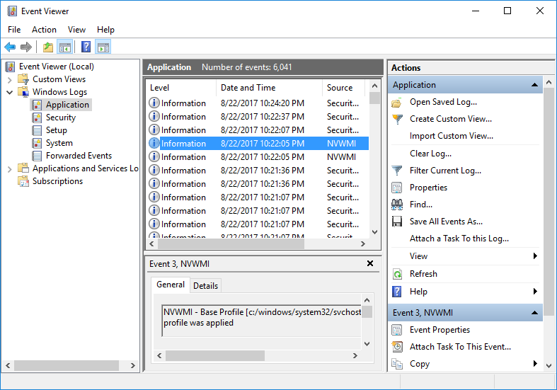
Event Viewer
Logging events is a common practice in software development and troubleshooting.
The logs of all Windows services can be read in the Event Viewer.
This is a great place to go when troubleshooting, especially with login and boot issues.

Slide 41
Exercise 3: Reading the Logs
Using the Event Viewer:
When did your computer last boot?
Did any Warnings or Errors occur when it booted?
When did you last log in?
Advanced:
Find the logs for Windows Store. Why is it so active?

Slide 42
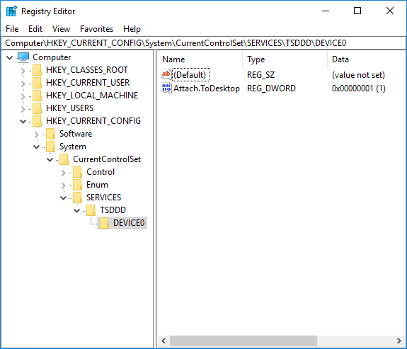
Registry Editor
The registry is a database of configuration values used by Windows.
The Registry Editor is used to manually review and edit these values. Open it by searching for regedit.
In 2017, this is rarely the preferred way to solve configuration problems.

Slide 43
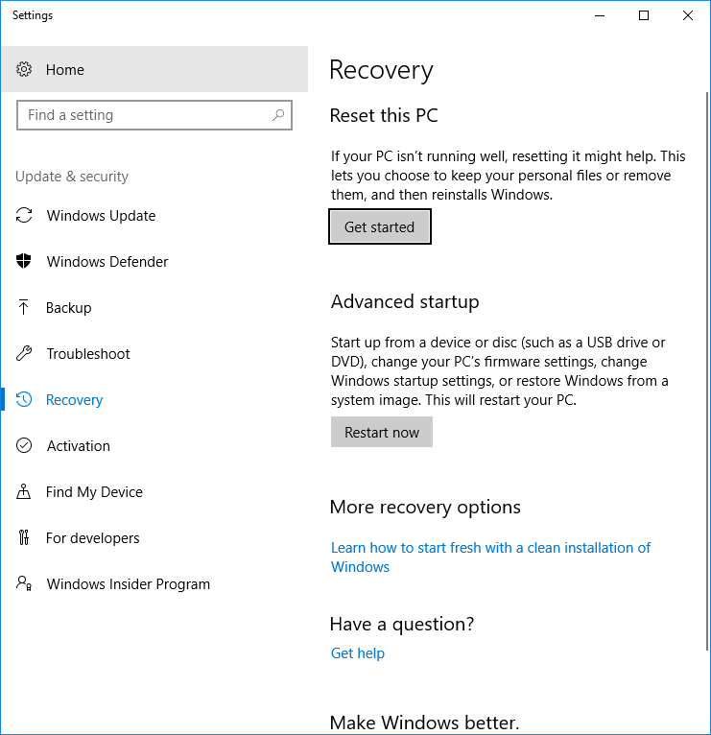
Recovery
The Windows 10 recovery tools are useful when:
You have an unsolvable problem that has to do with drivers or system configuration.
You want to wipe out all programs and “start over”.

Slide 44
Networking

Slide 45
What is a Network?
A network is just a bunch of connected computers
Some of those computers on that network are special
Internet
Network of computers all over the world
World Wide Web
Collection of webpages and the way we access them over Internet

Slide 46
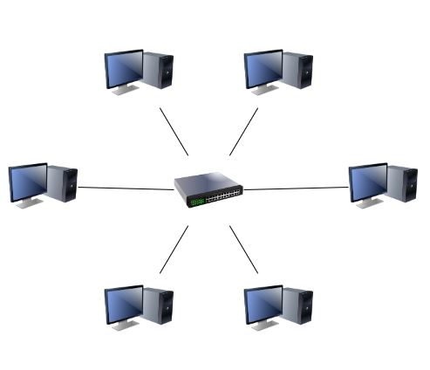
Networks by size
PAN – Personal Area Network
Bluetooth for example
LAN – Local Area Network
A building, school, company
WLAN – Wireless Local Area Network
Same as LAN but wireless
MAN – Metropolitan Area Network
City size network
WAN – Wide area network
Very large area (The Internet is a WAN)

Slide 47
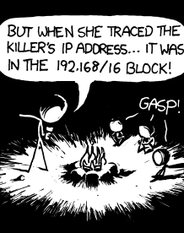
IP Address
The IP address is the address of a computer on a network
Most commonly 4 numbers from 0 to 255, separated by a period.
Local network addresses usually follow the pattern: 192.168.x.x
Other addresses to know:
127.0.0.1 – Your own address
8.8.8.8 is a good place to check connection to
- This is Google’s DNS server

Slide 48
Network components
Switch
Splitter that allows you to connect more devices
Router
Connects two or more networks
Usually contains NAT, DHCP, DNS proxy server and a Switch
Modem
Connects a network to the internet
Over telephone, cable,…
Hub
Very primitive splitter
Not really used for anything anymore
Notes:
Tell them to ignore Hubs. No one cares about them.

Slide 49

WiFi
Just a wireless network
Most WiFi access points (APs) are just Wireless Switches
Also known as IEEE 802.11
Many different protocols
Works on 2.4 or 5.0 Ghz
Neither is better, they are different
Slow connection doesn’t necessarily mean weak signal
Too many devices, or too many networks can also cause this!
Notes:
2.4 Ghz
-Twice the range
-only 12 - 14 channels (only 3 non overlapping)
5.0 Ghz
- shorter range
- almost 200 channels

Slide 50
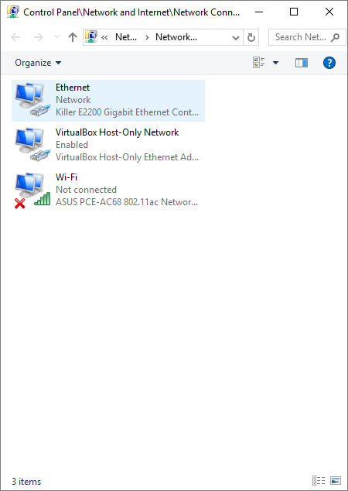
Network adapters
Hardware devices in computer used to connect to networks
WiFi, Ethernet, optical, Bluetooth,…
Can be virtual
In Windows:
Network and Sharing Center
Network Connections
Device Manager
Listed with ipconfig

Slide 51

Firewall
A firewall is software that allows or blocks applications that want to communicate over a network.
A firewall contains rules that can be turned on and off, allowing or blocking certain programs or ways of using a network.
If an application is having trouble connecting over a network, it might be blocked on your firewall.

Slide 52
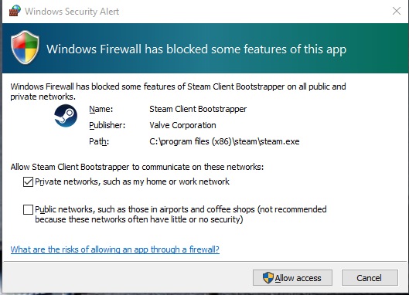
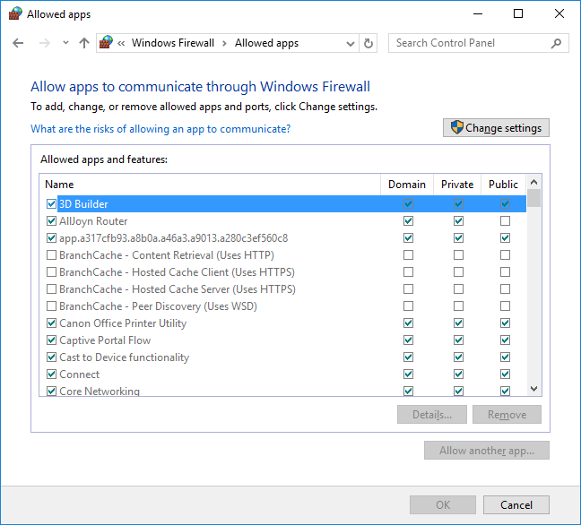
Windows Firewall
Windows has a built-in firewall.
There are a number of easy-to-use tools for configuring the firewall in Windows:
- Control Panel -> Windows Firewall
Windows Firewall tool
Options in Windows Defender

Slide 53
Exercise 4: Network Configuration
Using the Windows network configuration tools:
Figure out what your IPv4 address is on the VIA WiFi network
Using the Windows Firewall configuration tools:
Look at the applications that are allowed or blocked on your computer. Are there any surprises?
Advanced:
Find the address of your current router (“Default Gateway”)
Type this address into your web browser. What happens?
(Later) Try this on your home network. What happens?
Notes:
You can move this to the previous slide!

Slide 54
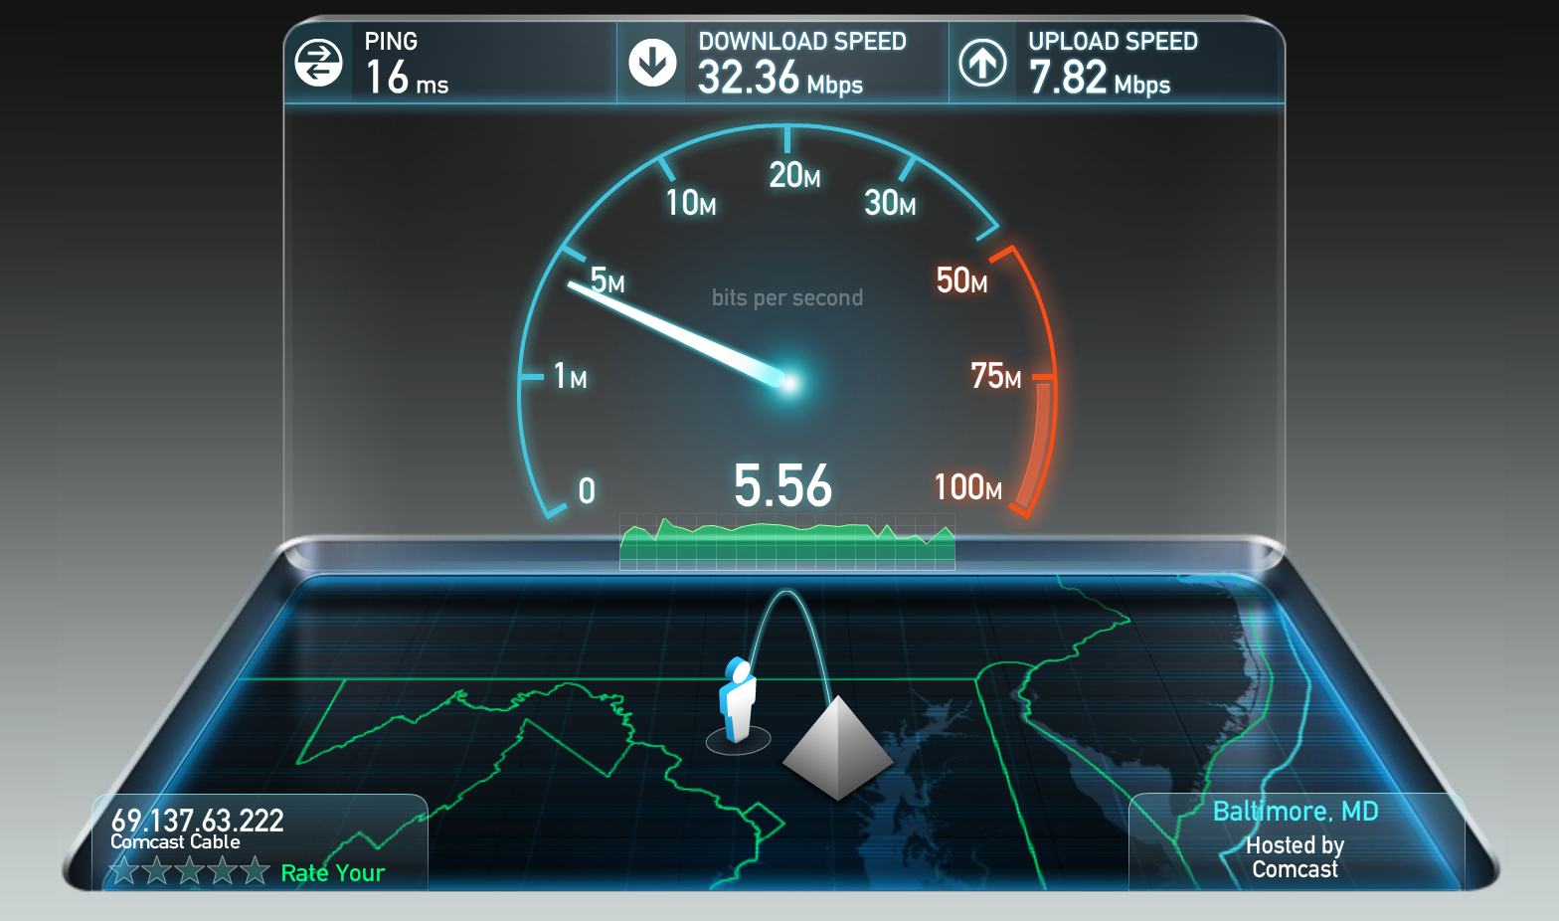
Other networking terms
Latency
The time between message is sent and arrives
Measured in ms
Bandwidth
How much data can go over a connection
Mbps (Mb/s)
Speed
Download
How fast you get data from others
Upload
How fast you can send data

Slide 55
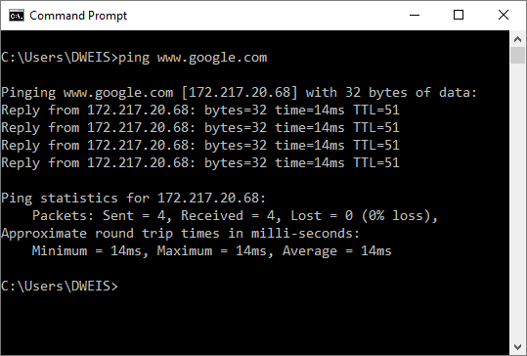
Command Prompt Debugging
ping
Works on most systems
Sends a message and waits for a response
Pinging 8.8.8.8 is a good way to check if you have access to the Internet
ipconfig (ifconfig on Unix)
Shows all network adaptors on the command line

